Slide 1
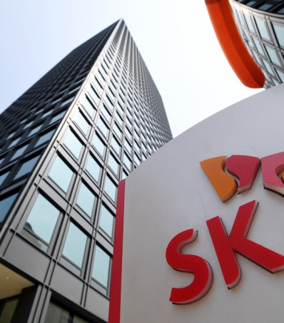
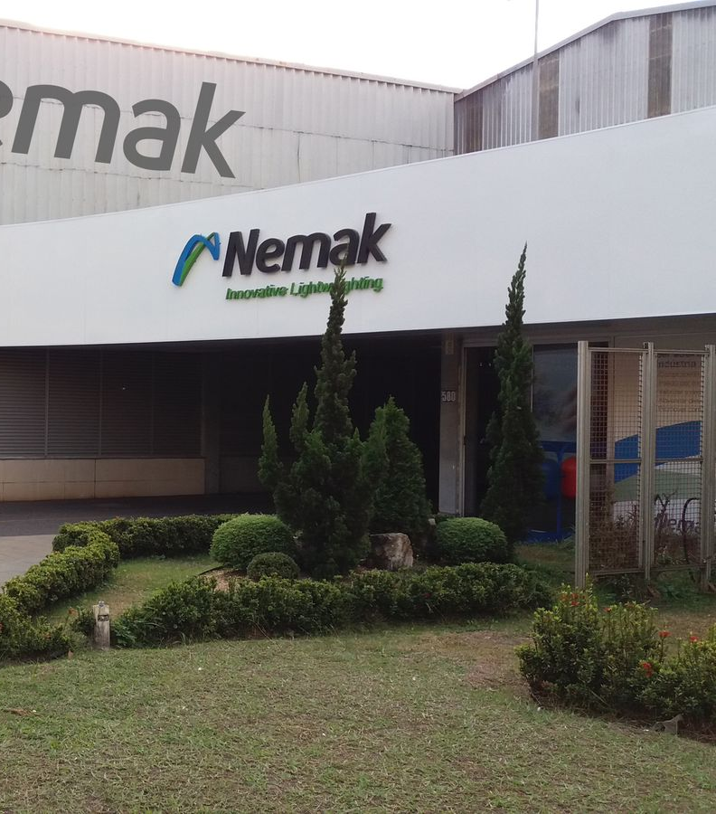
{COMPANY NAME}
{MONTH} - {YEAR}

Slide 2
{COMPANY_NAME} - Company Overview
``` Primary industry: Travel | Incorporation year: 2015 | Headquarters: Harrow, England | Employees: 250 | Group passengers served: 17,205 | Number of operating offices: 8 | Destination countries offered: 29 ```
Business Overview
Revenue Split (FY24)
Financial Highlight (FY22-24)
``` ──────────────────────────────────────────────────────────────────────── 2. Business Overview (bullets only) • Tour Partner Group is a multi-brand, business-to-business tour operator providing tailor-made group programmes throughout the UK, Ireland and the Nordic region. • The company trades through country-specific operating subsidiaries – e.g. Tour Partner Group UK Ltd, Tour Partner Group Ireland Ltd and Nordic Visitor – that deliver ground services and itinerary design. • It acts as an intermediate holding entity, housing the equity of its operating businesses and centralising treasury, IT, HR and certain procurement functions for the wider group. • The company continues to invest in additional geographic presence, opening new offices in Edinburgh and Copenhagen during FY22 to improve customer proximity and supplier relationships. • It emphasises customer intimacy, dedicating significant staff time to post-tour feedback loops and embedding those learnings in product design and operational processes. • Tour Partner Group benefits from supportive shareholders that have provided incremental loan-note funding since the FY22 balance-sheet date, reinforcing liquidity while international travel markets fully normalise after Covid-19. • It qualifies for Streamlined Energy & Carbon Reporting for the first time in FY22, with energy data currently limited to its London office; management has made further commitments to reduce the group’s carbon footprint in subsequent years. Sources: FY22 directors’ report pp.1-3; company website “About us” page. ```
``` 3. Revenue Split (FY22) The parent entity is an intermediate holding company and, in accordance with s.401 CA 2006, is exempt from preparing consolidated financial statements; therefore no external revenue is reported at parent level and no geographic or segmental split is available. Revenue at Tour Partner Group Limited in FY22, FY21 and FY20 is £0.0 m (statutory P&L, p.10). ```
| Metric | Value | |------------------------------------------------------------|-------| | Fixed-asset additions at holding-company level (FY22) | £0.0 m | | Equity injected into Tour Partner Group UK Ltd (FY22) | £1.0 m |
As a pure holding company Tour Partner Group Ltd generates no external revenue or gross profit, so performance is driven by costs and financing flows; FY22 EBITDA stayed negative and widened slightly as central-office re-openings, cyber-security spend and head-count for new locations offset the end of UK Covid support. Net working-capital balances, largely inter-company receivables, were kept flat through prompt settlement, while no capex was booked at parent level—capital investment occurs in operating subsidiaries, funded in FY22 by a £1.0 m equity injection into the UK unit. Financing cash inflow of £1.5 m came almost entirely from additional shareholder loan-note subscriptions, with no dividends distributed. These new loans pushed gross debt to £8.2 m and net debt to £7.8 m; leverage remains volatile because it is measured against negative EBITDA, but directors focus on cash-interest coverage and have secured waivers that ignore non-cash FX translation effects.
Key Recent Developments
Manufacturing Footprint
Key Recent Developments
Geographical Footprint
Capital Structure Summary (as of Dec-24)
| Metric | Value | |---|---| | Shareholder – Prevost Holding S.à r.l. | 54.9 % | | Shareholder – Máni ehf | 22.1 % | | Shareholder – Management & other minority | 23.0 % | | Chairman | Mr. Guðmundur Jónsson | | Chief Executive Officer | Mr. Ian Smith (appointed 03-Apr-23) | | Chief Financial Officer | Mr. Mark Kajberg | | Lender – Silicon Valley Bank UK (RCF) | – | | Lender – Shareholder loan-note holders (Prevost Holding S.à r.l., Máni ehf) | – | | Auditor | BDO LLP (London) | | Charges outstanding | None (checked 20-Jun-24) |
Net debt increased modestly in FY22 as new shareholder loan-notes funded expansion, but leverage remained stable because EBITDA losses widened in parallel. Post-year-end the SVB revolving credit facility was extended to Sep-26, converted to quarterly minimum-liquidity tests and retains a springing 3.0x leverage covenant that is currently far from being triggered due to low utilisation. Both the RCF and loan-notes are secured on subsidiary shares, bank accounts and inter-company receivables, with the shareholder debt structurally junior. Year-end liquidity stands at £1.2 m and can be boosted by a £1 m accordion, which together provide comfortable covenant headroom; stress tests show a >£0.6 m buffer over the next 12 months. The extended RCF now matures ahead of the Oct-25 loan-note bullet, which management plans to refinance or equitise well before due date to avoid pressure on covenant and liquidity metrics.
Key Stakeholders
``` 6. Key Stakeholders Table (all values FY22 unless stated) Shareholders (register of members, confirmation statement 10-May-24) • Prevost Holding S.à r.l. – 54.9 % • Máni ehf – 22.1 % • Management & other minority – 23.0 % Management • Chairman – Mr. Guðmundur Jónsson • Chief Executive Officer – Mr. Ian Smith (appointed 03-Apr-23; FY22 accounts note) • Chief Financial Officer – Mr. Mark Kajberg Lenders / MLAs (note 9, loans & borrowings) • Silicon Valley Bank UK – RCF lender • Shareholder loan-note holders (Prevost Holding S.à r.l., Máni ehf) Advisors • Auditor – BDO LLP (London) Charges: none outstanding or created to date (Companies House “charges” register checked 20-Jun-24). ```
Sources: Company financial statements, Company website, Debtwire, CIQ, Bloomberg, News
Notes: 1) Advisors to the company; 2) The values for LTM 1Q25 is not included in the financials table as the update does not provide detailed cash flow data; 3) Excluding net working capital and taxes paid

Slide 3
Organisational Structure
Organisational Structure
Organisational Structure
Ultimate Parent
Operating Subsidiary
Focus Company
Debt

